Slide 1


ERP IMPLEMENTATION AT IBS SOFTWARE
A Case Study on Oracle Cloud Fusion ERP Adoption
Presented By : Divya Chowdary Koripalli
1
Notes:
Hi everyone! My name is Merelyn and I'm here with my team members Divya & Vina. Today we present our findings on the ERP implementation journey at IBS Software.

Slide 2

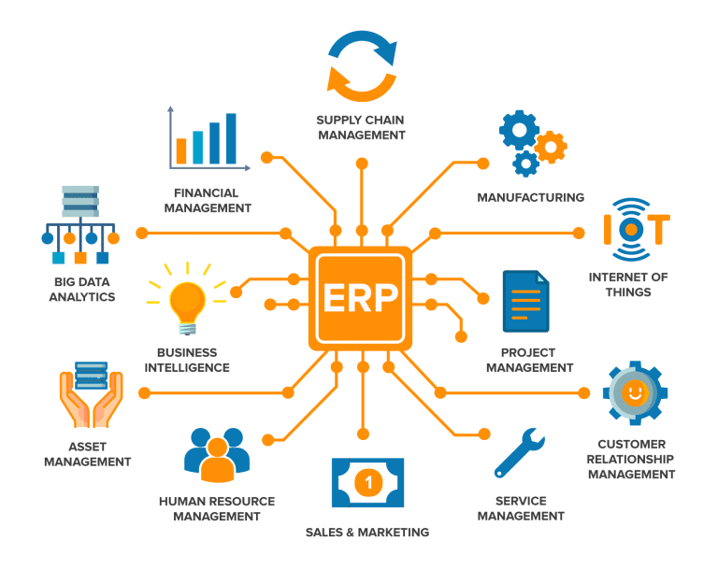
AGENDA
Company & Interviewee Background
Motivation for Adoption
Pre-ERP Systems & Challenges
Internal & External Drivers for ERP
Data Management before ERP
Good Practices before ERP
Pre-ERP Issues & Examples
ERP Implementation Timeline
Project Team & Implementation Approach
Implementation
Data Management after ERP
Tools, Reports & Ongoing Issues
Strategy & Lessons Learned
2
Notes:
Over the next few minutes, we’ll walk you through the company’s background, the issues they faced before ERP, and how Oracle ERP transformed their operations — along with the bumps that they faced.

Slide 3


COMPANY & INTERVIEWEE BACKGROUND
IBS Software Overview:
Industry: IT solutions for travel, transportation, logistics
Founded: 1997
Headquarters: Trivandrum, India
Employees: 3,500+
Key Clients: 170+ airlines, airports, and cruise lines
Core Products:
Airline operations (crew, cargo, passenger systems)
Hospitality tech
Energy logistics platforms
Interviewee:
Name: Mr. Ajith Ashok
Position: Account Executive
Department: Accounts Payable
Role: Testing the system’s invoice workflows and coordinating with IT for payment data migration.
Note: Ajith consulted with other seniors for assisting with this project.
3
Notes:
Alright, before we get into the ERP part, let’s take a quick overview of the company we focused on — IBS Software.
IBS is a multinational IT firm headquartered in Trivandrum, India. They were founded in 1997 and currently have over 3,500 employees across various global locations.
The company provides critical software solutions to clients in the aviation, travel, hospitality, and logistics industries. That includes everything from airline reservation systems to flight operations, crew scheduling, cargo tracking, and even energy logistics for oil and gas companies.
As of today, they serve over 170 global clients, which includes some of the world’s biggest airlines, airports, and hotel chains — so you can imagine the scale and complexity of their operations.
For this project, we had the chance to interview Mr. Ajith Ashok, who works as an Account Executive in the Accounts Payable department which was significantly impacted during the ERP rollout — especially during the finance and procurement module implementation. He played a key role in testing the system’s invoice workflows and coordinating with IT for payment data migration. He consulted with other seniors as well to give us valuable insights into how the system was selected, the issues they were trying to fix, and how the new ERP transformed the way IBS operates internally.

Slide 4


MOTIVATION FOR ADOPTION
ERP System Adopted: Oracle Cloud Fusion ERP (implemented from 2021 onward)
Legacy system (Tally ERP) couldn’t support growing data volumes
Manual reporting and siloed operations
No real-time insights across departments
Business growth + post-COVID digitization push
Increasing complexity in financial and procurement processes
4
Notes:
So let’s talk about why IBS Software decided to adopt an ERP system in the first place.
Before 2021, they were using Tally ERP, which is a pretty basic accounting software. It worked when IBS was smaller, but as the company expanded globally and took on more complex projects — especially in aviation and logistics — Tally just couldn’t keep up.
Mr. Ajith explained that one of the biggest issues was data silos. Each department maintained its own spreadsheets and records. There was no unified platform — so if Finance wanted procurement data, or HR needed salary info from Finance, it often meant digging through Excel files, sending emails, and dealing with multiple versions of the same report.
There was also no real-time reporting. Everything was done manually — from invoice generation to vendor payments. That not only slowed things down but also increased the risk of human error.
Then came COVID — and that really exposed the gaps. With everyone working remotely, the lack of a centralized, cloud-based system became a huge roadblock. Teams couldn’t access data at the same time, approvals were delayed, and reporting became a mess.
So in 2021, IBS adopted Oracle Cloud ERP — a cloud-based enterprise resource planning suite. This solution allowed them to automate processes, integrate functions across departments, and access data in real-time, from anywhere.
It was a major shift — from disconnected local tools to a centralized, cloud-powered system designed to scale.

Slide 5
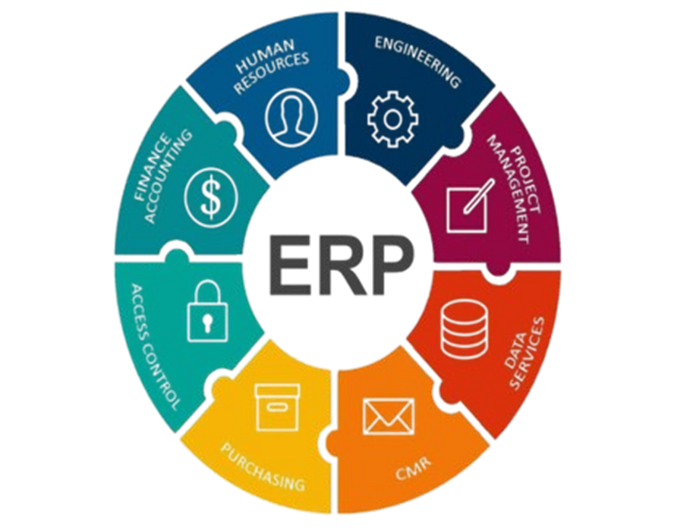
PRE-ERP SYSTEMS & CHALLENGES
System Used Before ERP:
Tally ERP (2008–2020)
Modules: Accounting, Inventory, Taxation
Deployment: On-premises, local access only
Challenges with Tally ERP:
No cloud access or multi-user collaboration
Financial closing took 8–10 days per month
No integration between finance, procurement, and HR
Frequent errors in vendor master data
Could not handle global-scale operations
5
Notes:
To understand why Oracle Cloud ERP was necessary, it’s important to look at what was going wrong with their old system — Tally ERP.
IBS had been using Tally since around 2008, primarily for accounting, basic inventory tracking, and tax compliance. But it was on-premises, not cloud-based, and had no integration features. Each team basically functioned in its own digital bubble.
For example, the finance team had no direct access to HR data for payroll processing. The procurement team couldn’t check real-time budget updates. So you had departments relying on manual coordination — phone calls, emails, shared drives — just to get routine tasks done.
According to Mr. Ajith, it sometimes took up to 10 days to complete month-end closing, just because data from different departments had to be manually collected and reconciled.
There were also data consistency issues. Vendor codes were often entered differently across departments. In some cases, duplicate entries or formatting mismatches created confusion in financial statements.
Tally also had no role-based access, which meant anyone with login credentials could see or modify sensitive financial data — a big security risk, especially for a global company dealing with international clients.
So by 2020, IBS realized Tally had become more of a bottleneck than a tool. They needed something modern, scalable, and collaborative. That’s what pushed them to start exploring enterprise-level ERP systems — eventually leading to their decision to go with Oracle Cloud ERP.

Slide 6
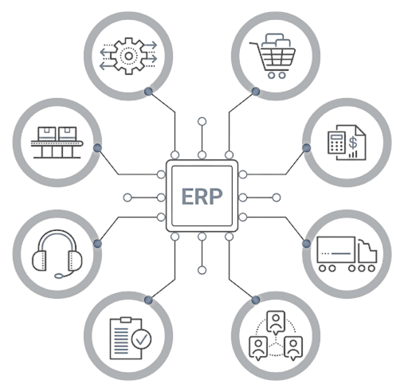
INTERNAL & EXTERNAL DRIVERS FOR ERP
Internal Drivers:
Business expansion
Need for automation and real-time data
Integration of operations across teams
External Drivers:
Remote work during COVID-19
Increased client expectations
Regulatory and audit requirements
6
Notes:
The decision to move to ERP was influenced by both internal and external factors.
Internally, IBS had grown significantly. They weren’t just offering services to a few domestic clients anymore — they were operating on a global scale, across aviation, logistics, and hospitality. With growth came complexity. They needed automation, role-based access controls, and real-time data sharing.
Externally, the push came from two main areas: the COVID-19 pandemic and increasing pressure from clients. Remote work exposed the limitations of their existing setup. Also, clients — especially international ones — expected faster response times, transparent billing, and performance reports. On top of that, auditors were asking for comprehensive financial data that the team could not easily extract from Tally.
So, between internal operational needs and external market pressure, it became essential to upgrade.

Slide 7
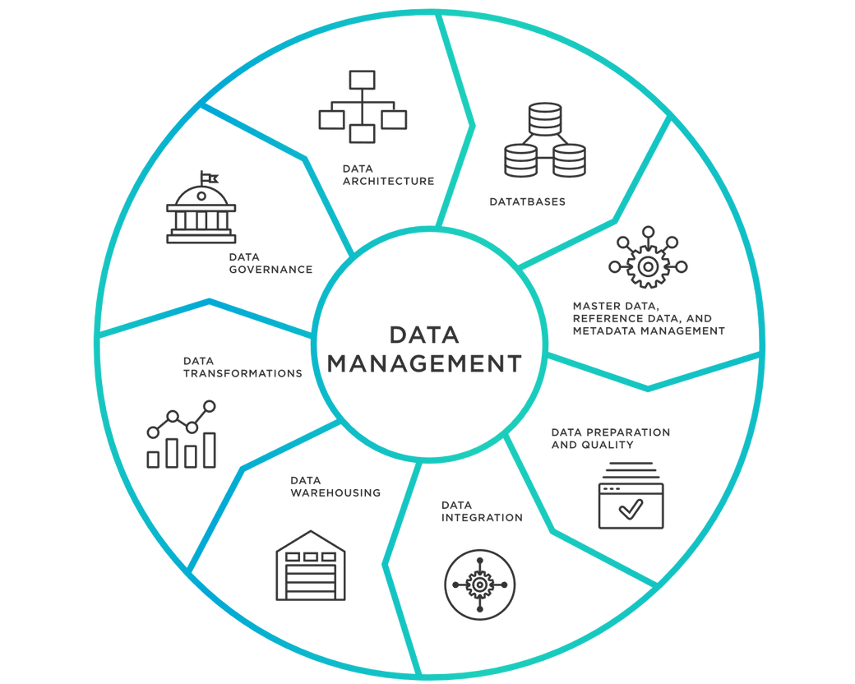
DATA MANAGEMENT BEFORE ERP
Methods Used:
Spreadsheets and Tally
Data stored locally
Sharing via email or USB
Manual backups and version tracking
Weaknesses:
No data governance policies
No centralized storage or audit trail
7
Notes:
Data management before ERP was fairly fragmented. Each team maintained their own spreadsheets and databases — usually on local drives or shared folders.
For example, if Finance needed expense records from Procurement, someone had to manually send those files over. Version control was a nightmare — Mr. Ajith mentioned situations where teams worked off two different versions of the same report.
There was also no formal backup policy. While Finance took monthly backups, HR and other teams were less consistent. Data recovery after a system crash could take days.
The lack of a single source of truth made it difficult to generate reports or share insights quickly, and these inefficiencies had ripple effects on everything from audits to vendor communication.

Slide 8

GOOD PRACTICES BEFORE ERP
What Worked Well:
Finance team kept regular backups
HR did monthly reconciliations
Procurement maintained clean vendor lists manually
8
Notes:
Despite the challenges, there were some bright spots. The finance team, for instance, had robust documentation and regular backups. They tracked every transaction meticulously, which helped during the transition to Oracle.
HR also had a habit of reconciling employee records every month, which helped catch inconsistencies before they became bigger issues.
Procurement, while still manual, used semi-structured templates to maintain vendor master lists — which reduced the chances of duplication or formatting errors. These departmental practices helped smoothen parts of the data migration process later on.

Slide 9

PRE-ERP ISSUES & EXAMPLES
Examples of Problems:
Duplicate vendor entries caused payment delays
Finance had to cross-check 3–4 sources for one report
Impact:
Month-end closing delayed by 7–10 days
Inconsistent audit reports
9
Notes:
Let’s break down some real examples of issues IBS faced before ERP.
One major problem was duplicate vendor entries. A single vendor might be listed under multiple names in different departments — for example, "ABC Ltd." in Finance and "A.B.C. Limited" in Procurement. This caused confusion during payments and made it difficult to track vendor history.
Financial reporting also suffered. To generate a single consolidated report, the finance team had to pull data from three or four different sources — none of which were synced in real-time.
There were regular mismatches in inventory and budget numbers, which made planning extremely difficult. During audits, these inconsistencies led to delays and additional scrutiny.
All these examples underscore why IBS needed an integrated system like Oracle Cloud ERP — to bring all departments onto the same platform and eliminate these inefficiencies.

Slide 10
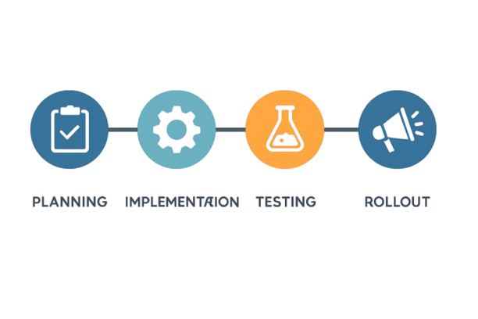
ERP IMPLEMENTATION TIMELINE
Aug 2019 – Mar 2020
Apr 2020 – Feb 2021
Mar 2021
Apr – Oct 2022
Nov 2022 – Sep 2023
Planning & Vendor Evaluation
COVID-19 Delay
Implementation Kickoff
Testing Phases
Final Rollout (Phased)
10
Notes:
Here’s a breakdown of the ERP implementation timeline at IBS Software.
The company began evaluating four ERP vendors in August 2019, including SAP and Microsoft Dynamics. After several months of analysis, they selected Oracle Cloud ERP by March 2020. However, the COVID-19 pandemic delayed internal alignment, pushing the actual kickoff to March 2021 — about ten months behind schedule.
Implementation followed a phased approach rather than a "big bang". Each module was tested over six months, and the final rollout spanned nearly 11 months — from November 2022 to September 2023. The rollout included over 1,500 employees across 4 business units, and redefined more than 30 key business processes.
This staged rollout helped the teams manage change more effectively, though delays and integration issues still emerged, which we’ll touch on shortly.

Slide 11

PROJECT TEAM & IMPLEMENTATION APPROACH
Project Team:
Core team: 15 members (6 internal IT, 3 Oracle consultants, 6 functional heads).
Over 100 hours of training delivered across 3 months.
Around 95% user certification was achieved before go-live in each department.
Total implementation cost estimated at USD 750K, including consulting, licensing, and training.
Approach:
Phased rollout by module
Data migration in multiple waves
Department-wise training and certification
11
Notes:
The ERP project was led by a 15-member core team. It included 6 internal IT staff who handled technical configuration, 3 Oracle consultants with deep system expertise, and 6 functional heads who ensured each department’s needs were aligned.
The implementation was phased — Finance was rolled out first, followed by Procurement, HR, and finally Inventory. This approach made the learning curve more manageable and reduced risk.
Training was an essential part. Over 100 hours of live and virtual training were delivered. By go-live, 95% of end-users had completed certification, and each department had designated super-users. The total implementation cost was around USD 750k, including Oracle licensing, consulting fees, and training expenses.

Slide 12
IMPLEMENTATION
Challenges Faced:
Data migration breakdown during full-scale uploads
Interfacing issues with legacy HR and logistics systems
Pressure to complete before FY-end
Need for manual re-entry of many records
Data migration issues caused a 25% delay in Phase 1.
Legacy system incompatibility delayed HR and logistics integration by 6 weeks.
Finance team reported 20% increase in workload during reformatting phase.
Key Solutions:
In-house Python scripts cleaned data 4x faster than manual methods.
Middleware integration reduced HR sync lag from 8 hours to 20 minutes.
8 sandbox patch cycles were conducted before go-live.
Oracle-certified super-users increased from 5 to 22 in 3 months, covering all departments.
12
Notes:
Despite a structured plan, IBS faced several roadblocks.
The biggest was data migration. Their initial tests with 1200-line sample files went smoothly. But when they scaled to over more number of records, things broke down. There were mismatches in vendor codes, formatting errors, and missing metadata. The finance team had to manually clean and re-enter many records, increasing their workload by almost 20%.
Another challenge was system interfacing. Oracle ERP couldn’t initially integrate with IBS’s legacy HR and logistics software, causing sync delays. This delayed the HR phase by over 6 weeks.
Moreover, because the rollout deadline was tied to the financial year-end, there was pressure to push forward before full testing was completed — a decision that caused minor setbacks in data alignment.
To tackle these issues, IBS rolled out several corrective strategies.
First, their IT team developed Python scripts to automate data cleansing. These scripts processed records four times faster than manual corrections.
Second, they built a custom middleware to bridge Oracle ERP with older HR and logistics platforms. This reduced data sync lags from 8 hours to under 20 minutes.
To ensure stability, they introduced a sandbox testing environment. Every Oracle patch went through 8 rounds of testing before deployment to live servers.
And finally, IBS expanded their pool of Oracle-certified staff. Over three months, they trained 22 super-users, who helped their departments navigate the ERP system and supported troubleshooting.

Slide 13
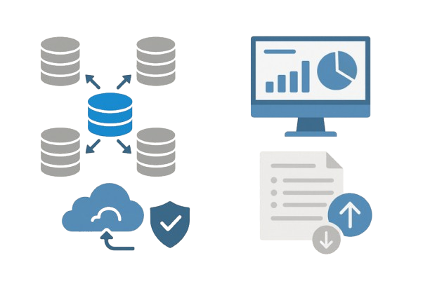
DATA MANAGEMENT AFTER ERP
Changes Introduced:
Centralized data reduced duplication errors by 65%.
Oracle dashboards reduced reporting time from 2 days to under 2 hours.
Automated backups and role-based access improved audit readiness by 40%.
Version history features allowed traceability of 100% of financial entries.
13
Notes:
Post-implementation, IBS’s data ecosystem saw dramatic improvements.
All business units now operate from a centralized Oracle Cloud platform, which ensures consistency. Duplication errors were reduced by 65%.
Real-time dashboards provide visibility to leadership. Reporting time dropped from 2 days to under 2 hours, especially for finance and procurement.
Backups are now automated, and each record has version control and audit trails — which improved audit readiness by 40%.
It’s easier to make decisions quickly, and the company is far better prepared for audits and compliance checks.

Slide 14
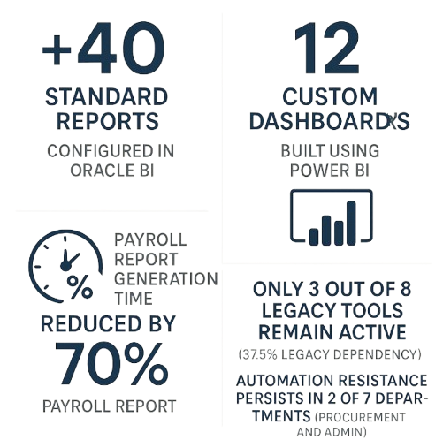
TOOLS, REPORTS & ONGOING ISSUES
Tools Used:
Oracle Business Intelligence (BI) for standard reports
Power BI for custom dashboards
Internal scripts for data extraction
Reports Generated:
Budget vs. actual analysis
Vendor performance reports
Payroll and leave summaries
Ongoing Issues:
Sync delays between ERP and legacy tools
Resistance to automation in some teams
14
Notes:
IBS now uses a mix of tools to turn data into insights.
Oracle BI helps generate over 40 standard reports, from financial summaries to procurement tracking. Additionally, they’ve built 12 custom dashboards in Power BI for their executive team — showing KPIs, vendor scores, and HR trends.
Payroll report generation, which used to take over a day, is now completed in under 4 hours — a 70% improvement.
However, not everything is smooth. Three older tools still exist alongside Oracle, causing sync delays, especially in inventory updates.
Also, 2 departments — Procurement and Admin — still show resistance to automation, preferring manual overrides. IBS is working on targeted training and policy updates to encourage smoother adoption.

Slide 15
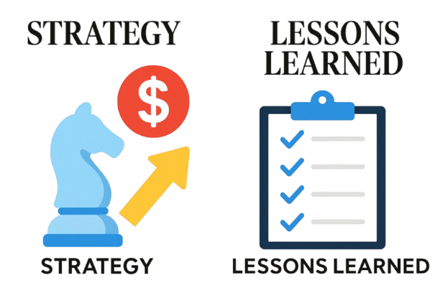
STRATEGY & LESSONS LEARNED
Strategic Plans:
Phasing out legacy systems is projected to save $100K/year in maintenance costs.
Plan to roll out Oracle CRM and Project modules by Q2 2025.
Data audits scheduled bi-annually, involving 2 internal auditors and 1 external partner.
Training budget for 2024–25 set at USD 60,000 to boost ERP literacy.
Lessons Learned:
Don’t rush the implementation
Test with full datasets, not just samples
Prioritize data formatting and quality
Invest in user training early
15
Notes:
Looking ahead, IBS plans to eliminate legacy systems by Q4 2025, which is expected to save $100,000/year in maintenance costs.
They’ll also expand their Oracle suite to include CRM and Project Management modules by the end of 2025.
The company has committed to bi-annual data audits, involving 2 internal data specialists and 1 external partner. Their 2024–25 training budget is $60,000, aimed at upskilling another 50 users.
Mr. Ajith emphasized several lessons: never rush an ERP rollout — especially near fiscal deadlines; always test with real data sets; and ensure data is clean and structured before migration.
Most importantly, train early. Empower your users — because even the best system won’t work if your people aren’t comfortable using it.

Slide 16
Thank you.
16
Notes:
So to wrap things up — the ERP journey at IBS Software was challenging but ultimately transformative. Moving from Tally to Oracle Cloud ERP helped unify operations, streamline data management, and increase visibility across the company.
There were certainly hiccups — especially with data migration and integration — but with the right team, tools, and training, they were able to overcome those hurdles.
Thank you so much for listening. We’d love to hear your questions or thoughts!

